Slide 1

TITANIC SURVIVAL PREDICTION
TITANIC SURVIVAL PREDICTION
Group 1
Maria Alia Aguila
Eloiza Jean Atienza
Baby Jane Cabanjen
Daniela Aeryel Davadilla
Keesha Dela Peña
Milagros May Lozano
Notes:
https://colab.research.google.com/drive/1i7Izct-ETD4Tvn_32XVqEu_q-LBKsdET?usp=sharing#scrollTo=Mv-_XE7Iz2Cy

Slide 2
Questions:
What model did you use and why?
Share some basic EDA and data visualizations on the dataset
What questions do you have about the dataset? Is there anything you would want to explore further? What questions would you ask your “domain expert”?
What do your predictions look like? Does it make sense?
How did your model perform? (from what we’ve seen so far in class)

Slide 3
Data Cleaning
Exploratory Data Analysis
Model Development

Slide 4
DATA
CLEANING

Slide 5
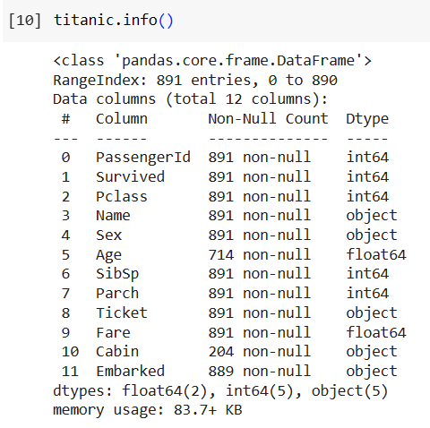
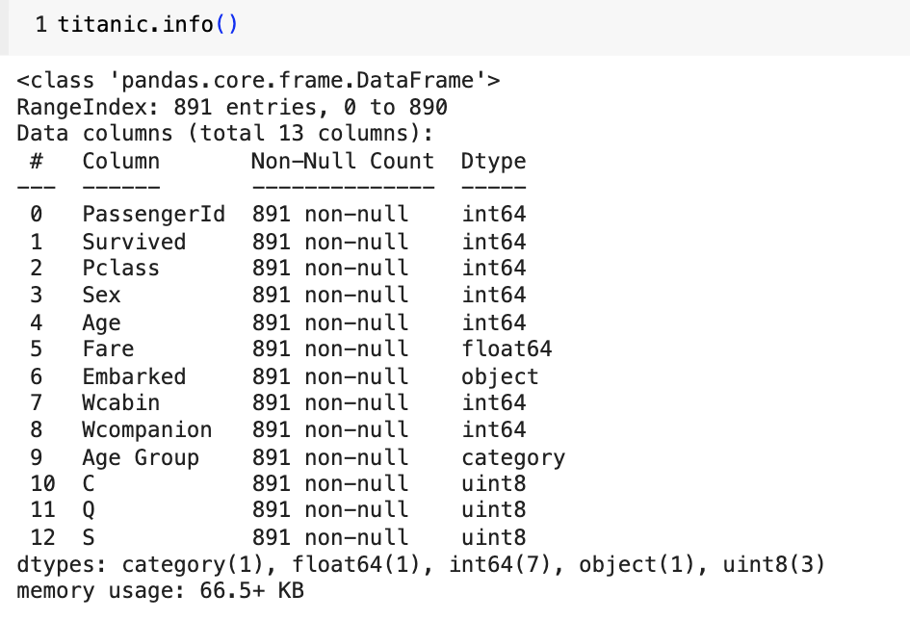
How we cleaned the data:
Before
After

Slide 6
1. Data Setup:
Imported necessary libraries.
2. Data Inspection:
Checked columns, shape, info, duplicates, unique variables, and null values.
3. Handling Missing "Cabin" Data:
Created another column “Wcabin” that assigns 1 to those with cabin and 0 to those without cabin details.
4. Handling "Embarked" Data:
Missing values: Filled null values in the "Embarked" column with the most common value (mode).
Values were separated into 3 individual columns of embarkation ports (S, C and Q) and converted into numerical format (dummy).

Slide 7
5. Handling Missing "Age" Data:
Grouped null values in the "Age" column by passenger class (Pclass) and filled them with the mean per class.
Converted the data type of ages from float to integers.
Performed discretization to create age groups. (Minor: 0-18, Young Adult: 19-35, Adult: 36-60, Senior: 61 or older)
6. Handling "Sex" Data:
Changed "Sex" values to numerical format (0: male, 1: female).
7. Handling "SibSp" and "Parch" Data:
Total the values of "SibSp" and "Parch" into a new column called "Wcompanion”
8. Dropping “Name” and “Ticket” Columns
Columns were not relevant to the analysis and only adds noise to the data

Slide 8
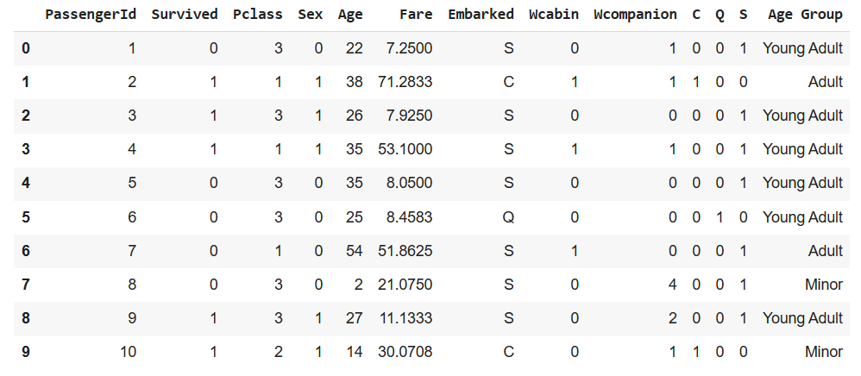
Cleaned Data
Dummy Variables for ‘Embarked’ (Categorical) and C, Q, S (Numerical)

Slide 9
EXPLORATORY DATA ANALYSIS

Slide 10
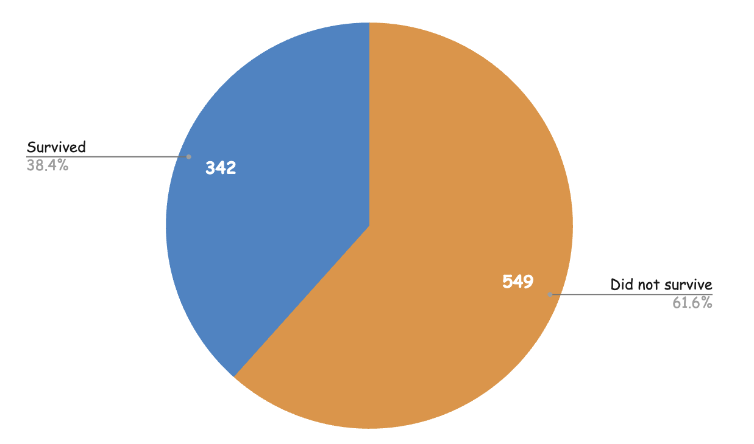
342 out of 891 passengers, or only 38.4 % of the passengers survived the Titanic.

Slide 11
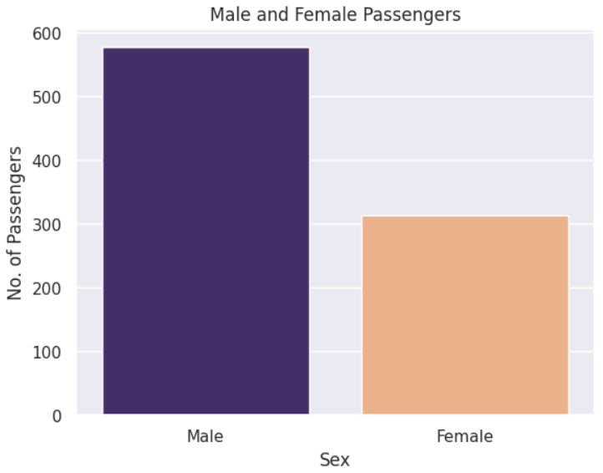
There were more male than female passengers.

Slide 12
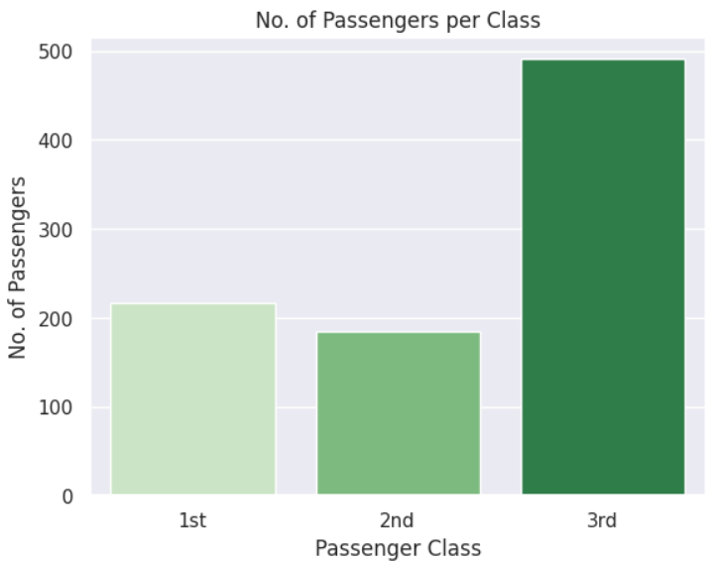
Most passengers of the Titanic are in the 3rd class.

Slide 13
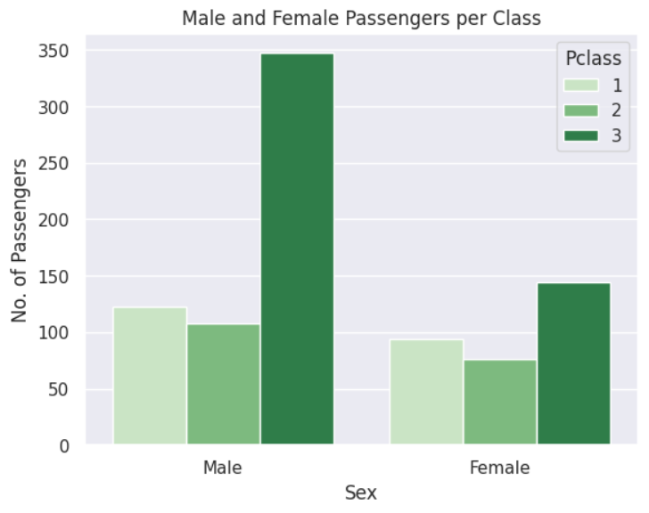
There were more males per class. Number of males in the 3rd class is more than twice the number of females.

Slide 14
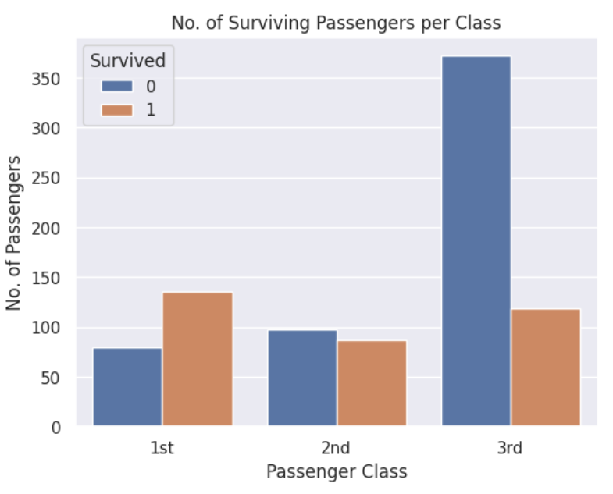
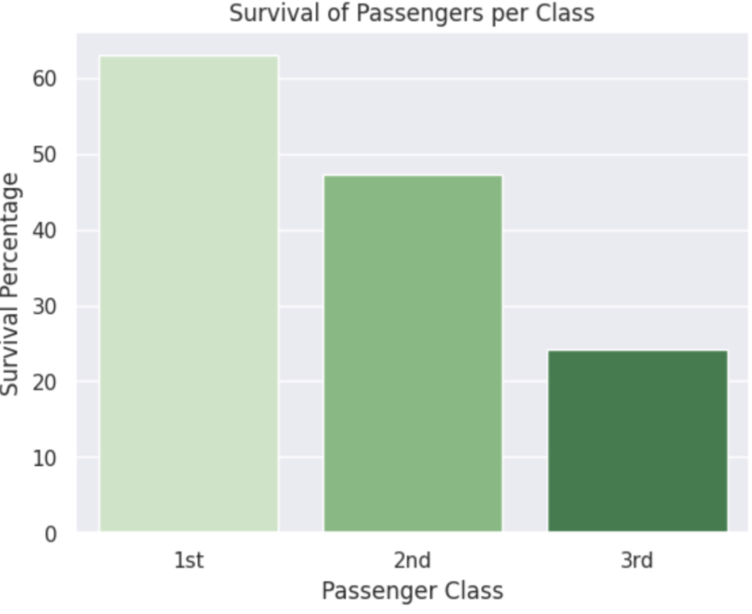
More passengers in the 1st class survived.
Most passengers in the 3rd class did not survive.
63%
47%
24%

Slide 15
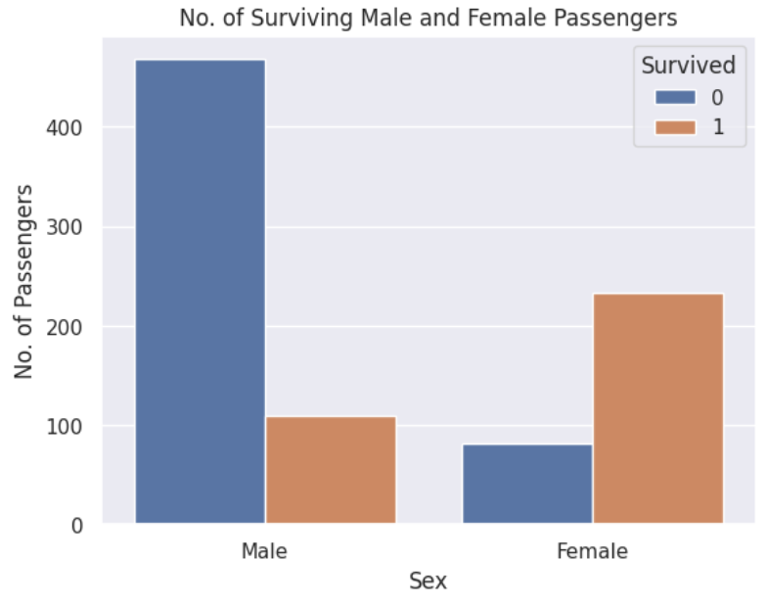
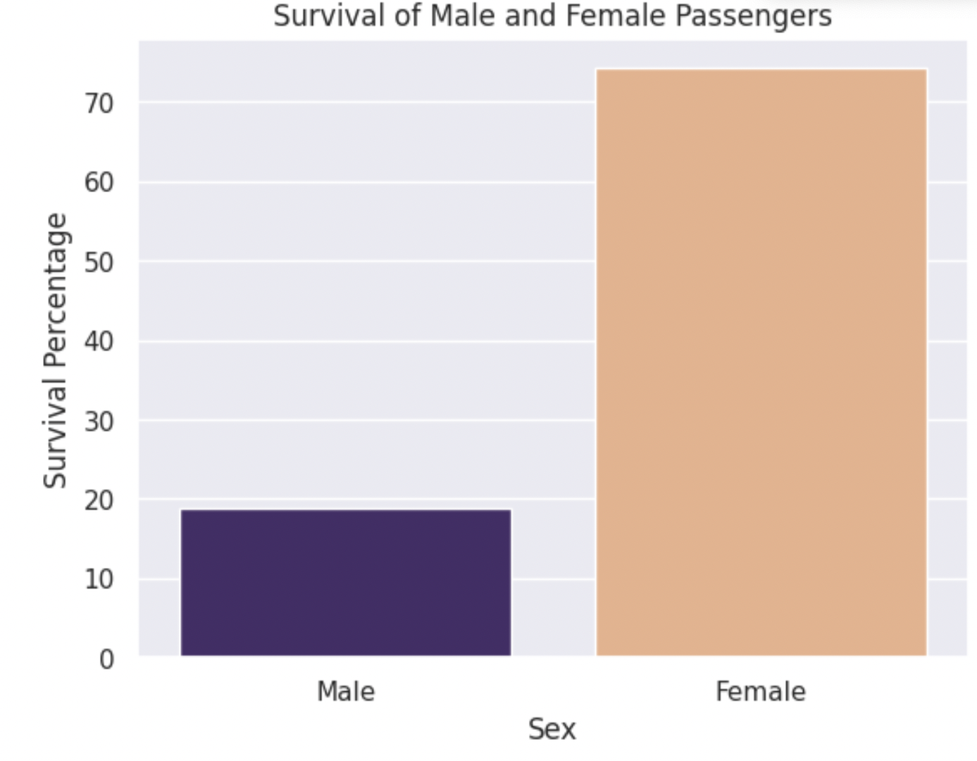
Females had a higher survival rate than males.
74%
19%
Notes:
Suggestion:
Combo chart — bar (actual number) + line (percentage)

Slide 16
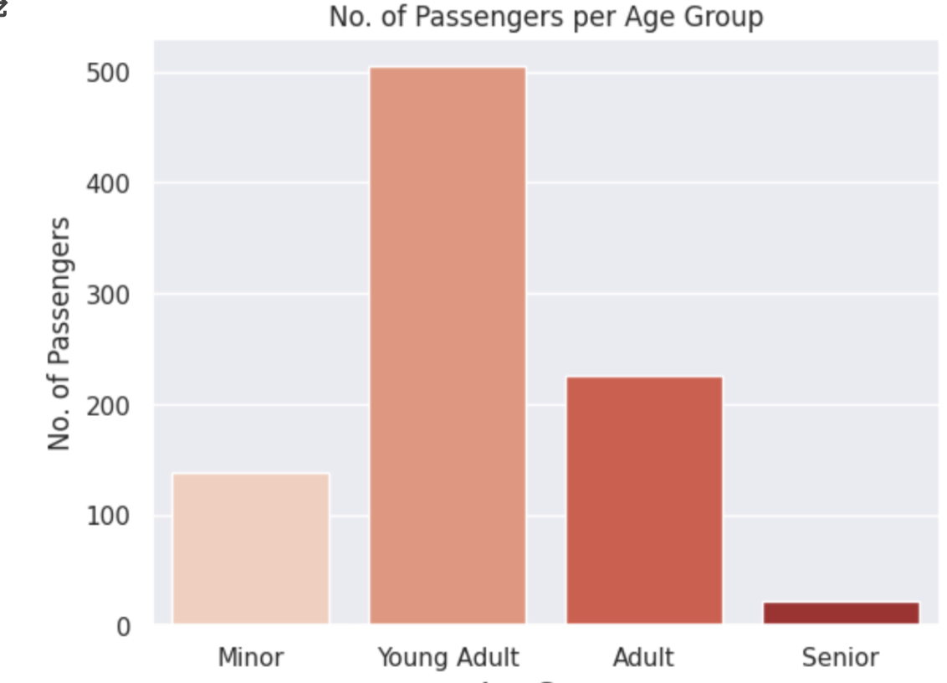
Most passengers are young adults who are 19 to 35 years old.
(0-18)
(19-35)
(36-60)
(61 or older)
Notes:
Combo charts, stacked with line graphs, or text label of percentages
Pagsamahin na lang sa isang slide para makita yung ratio

Slide 17
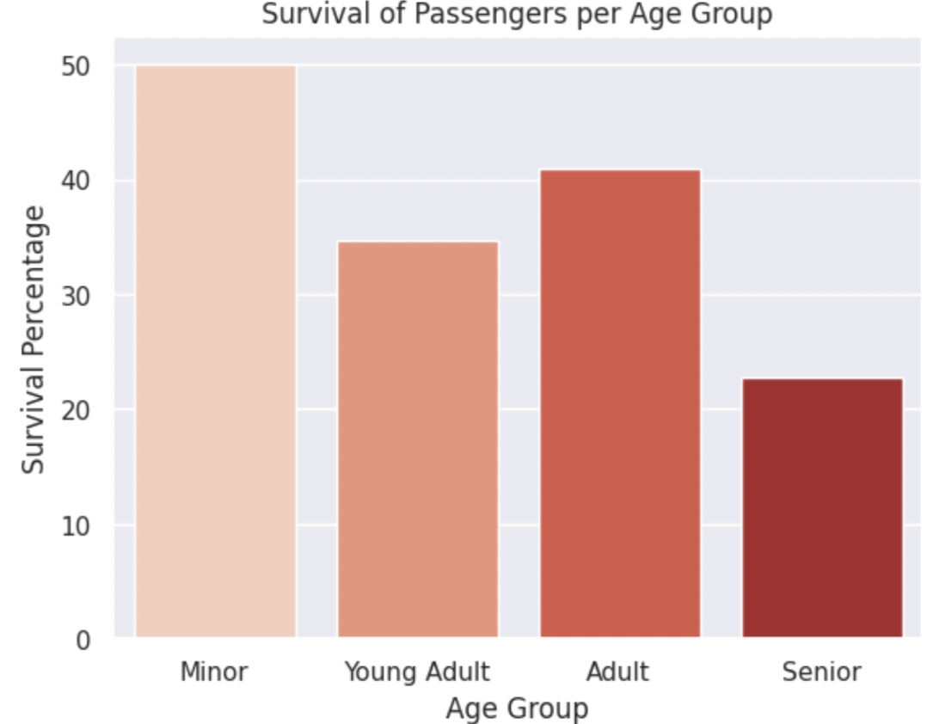
50% of the minors (0-18 years old) survived due to their priority consideration. Other age groups have less than half survival rates. Young adults (19-35 years old) have the most number but only have 35% survival rate.
50%
40%
35%
23%
(0-18)
(19-35)
(36-60)
(61 or older)

Slide 18
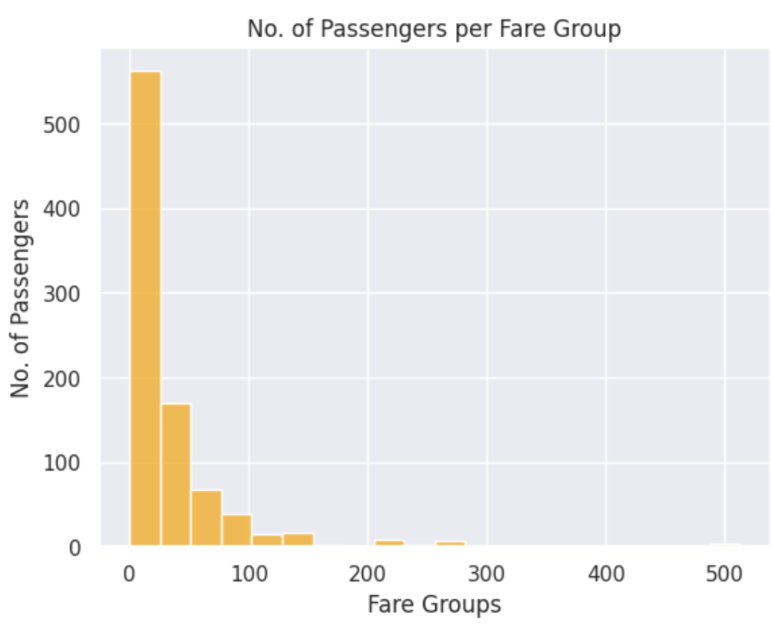
Most of the passengers purchased the lower fare.

Slide 19
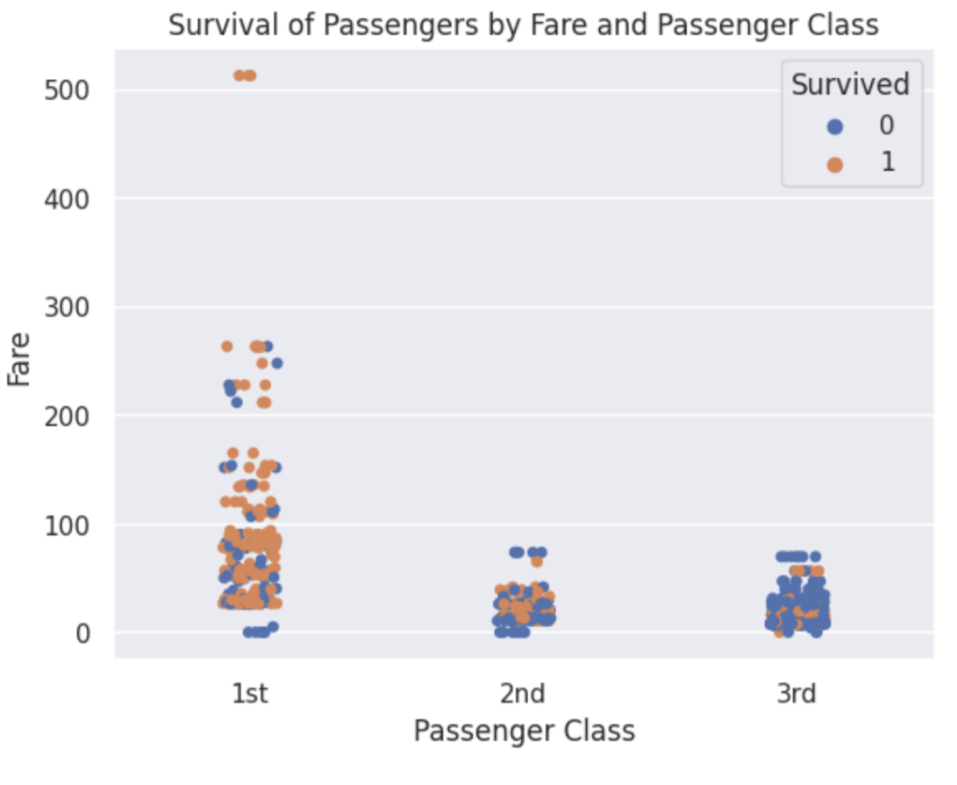
Some of the 1st, 2nd and 3rd class passengers had the same fare values.

Slide 20
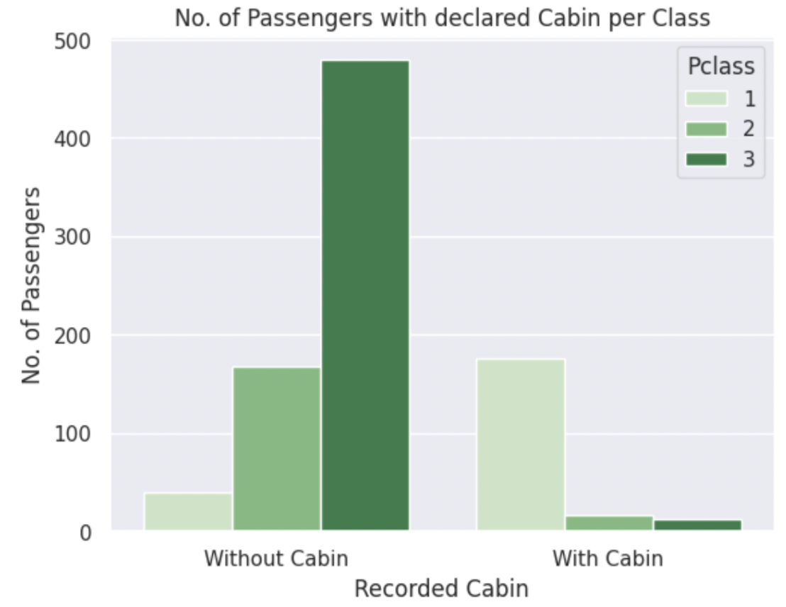
Most passengers with cabin details are 1st class passengers. Most of those who do not have are in 2nd and 3rd class.
Notes:
After assigning 1 to those with recorded cabins and 0 to those without, we were able to determine the number of cabins registered per class.
The bar graph illustrates that those from Pclass 1 had the most with over 100 recorded cabins.

Slide 21
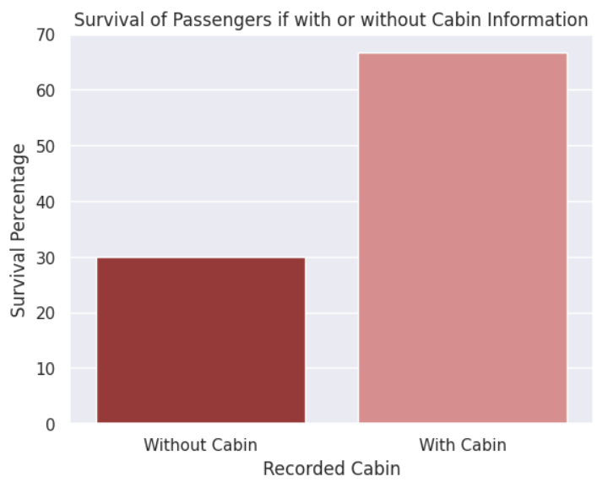
Only 30% of passengers without cabin details survived while 67% with cabin details survived.
67%
30%
Notes:
In terms of survival rate, only 30% of all passengers without recorded cabin survived while 67% of all passengers with recorded cabin details survived the titanic.

Slide 22
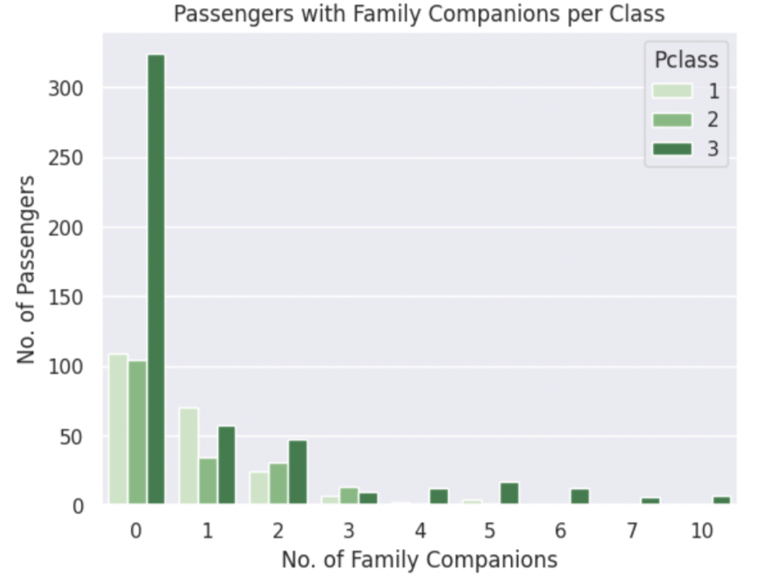
Most passengers with family companions are in the 3rd class.
Notes:
Here we’ve shown the number of people with family companion per class. Those without companion are predominant in all classes with Pclass 3 having up to 10 family companions.

Slide 23
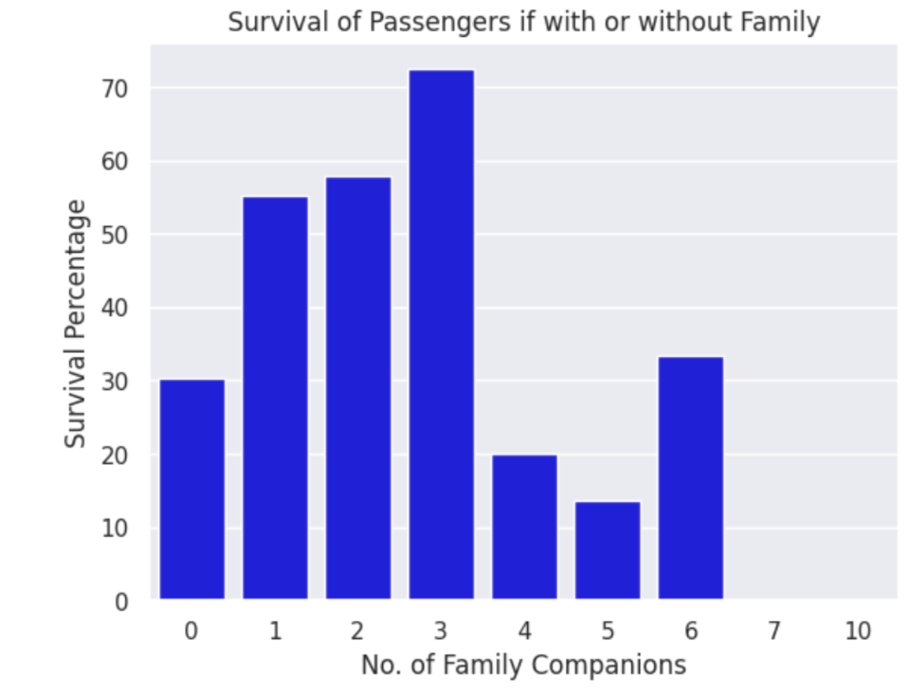
Passengers with 1-3 family companions had higher survival rate than those with more or without family.
Notes:
Passengers with 1-3 family companions had higher survival rate than those with more or without companions, notably, those with 3 companions had the most with survival rate of more than 70%.

Slide 24
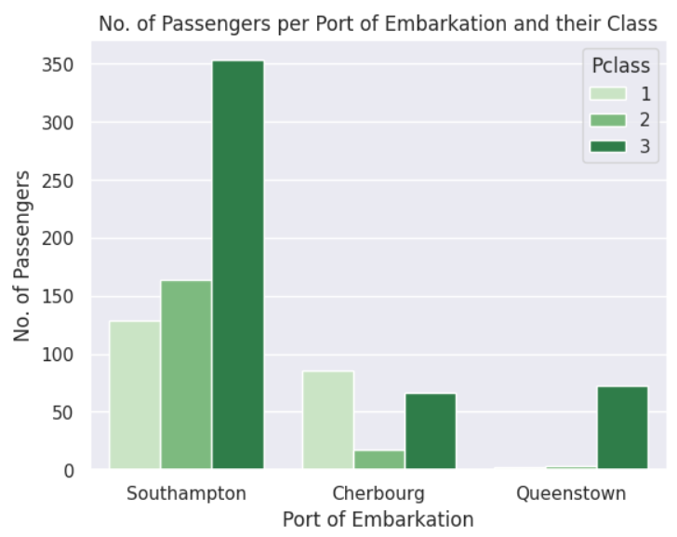
Most passengers who boarded from Cherbourg are in the 1st class. Most passengers who boarded from Southampton and Queenstown are in the 3rd class.
Notes:
Finally, we investigated the number of passengers in terms of the port where they embarked. All passengers predominantly embarked Southampton port. Most passengers that embarked in port of Cherbourg were in Pclass 1.

Slide 25
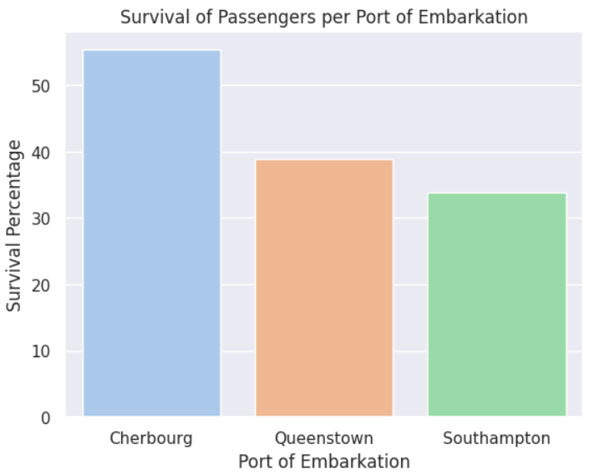
55% of passengers who boarded from Cherbourg survived while only
39% and 34% survived from Queenstown and Southampton, respectively.
55%
39%
34%
Notes:
As illustrated, only the passengers who boarded from Cherbourg, France had a survival rate of more than 50%, those that embarked from Queenstown, England and Southampton, USA were 39% and 34% respectively.

Slide 26
MODEL DEVELOPMENT

Slide 27
Features used: ‘Pclass’, ‘Sex’, ‘Age, ‘Wcabin’, ‘Wcompanion’, ‘Fare’, ‘C’, ‘Q’, ‘S’
Set X and y:
X= titanic [‘features’]
y= titanic [‘Survived’]
Train Test Split, Logistic Regression model for classification, Feature Importance, Confusion Matrix, Model Performance Metrics

Slide 28
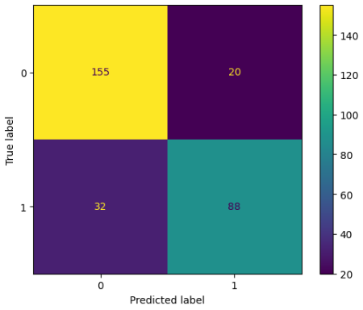
Confusion Matrix
Notes:
True Negative (TN): 155 instances were correctly predicted as non-survivors, and indeed, they did not survive.
True Positive (TP): 88 instances were correctly predicted to have survived, and they indeed survived.
False Negative (FN): 32 instances were incorrectly predicted as non-survivors, but they actually survived.
False Positive (FP): 20 instances were incorrectly predicted to survive, but they did not.

Slide 29
Performance Metrics
Precision Score: 0.81
Recall Score: 0.73
Accuracy Score: 0.82
Notes:
Precision is concerned with the accuracy of positive predictions.
Recall is concerned with the model's ability to capture all relevant instances.
Accuracy provides an overall measure of correctness.
A precision of 0.81 means that when the model predicts a positive outcome, it is correct about 81% of the time.
A recall score of 0.73 means that the model is able to correctly identify about 73% of the actual positive instances in the dataset.
The accuracy score of 0.82 provides an overall measure of correctness across both positive and negative predictions.

Slide 30
Feature Importance
Feature | Coefficient
Sex | +2.46
Pclass | -0.71
Wcabin | +0.59
Embarked_C | +0.33
Embarked_S | -0.29
Wcompanion | -0.20
Embarked_Q | -0.034
Age | -0.031
Fare | +0.0023
Notes:
Magnitude of coefficient is proportional to feature importance. The higher the magnitude of coefficient, the higher the impact of that feature to the target variable.
Sign of coefficient dictates whether the target variable increases or decreases when the value of that feature is increased.
(+) —> increasing the value of the feature increases the value of the target variable (leaning towards a value of 1)
(-) —> increasing the value of the feature decreases the value of the target variable (leaning towards a value of 0)
Ex: Sex is the most strongly associated feature with the chance of survival;
Fare has the least importance and may only be adding noise to the model.
Increasing the value of Sex (going from 0/male to 1/female) increases the chance of survival.
Increasing the value of Pclass (going from 1st to 3rd class) decreases the chance of survival.
Increasing the value of Wcabin (going from 0/without cabin to 1/with cabin) increases the chance of survival.
Increasing the value of C (going from 0/not boarding from Cherbourg to 1/boarding from Cherbourg) increases the chance of survival.
Increasing the value of S (going from 0/not boarding from Southampton to 1/boarding from Southampton) decreases the chance of survival.
Increasing the value of Wcampanion (more companions) decreases the chance of survival.
Increasing the value of Q (going from 0/not boarding from Queenstown to 1/boarding from Queenstown) decreases the chance of survival.
Increasing the value of age decreases the chance of survival.
Increasing the value of fare increases the chance of survival.

Slide 31

What if we remove ‘Fare’ from the model features?
With ‘Fare’
Without ‘Fare’
Notes:
Lower false positives and false negatives when ‘Fare’ was removed from the list of features used in the model.

Slide 32
What if we remove ‘Fare’ from the model features?
With ‘Fare’
Without ‘Fare’
Precision Score: 0.81
Recall Score: 0.73
Accuracy Score: 0.82
Precision Score: 0.83
Recall Score: 0.75
Accuracy Score: 0.83
Notes:
Improved precision, recall, and accuracy when ‘Fare’ was removed from the list of features used in the model.

Slide 33
What if we remove ‘Fare’ from the model features?
With ‘Fare’
Without ‘Fare’
Feature | Coefficient
Sex | +2.46
Pclass | -0.71
Wcabin | +0.59
Embarked_C | +0.33
Embarked_S | -0.29
Wcompanion | -0.20
Embarked_Q | -0.034
Age | -0.031
Fare | +0.0023
Feature | Coefficient
Sex | +2.46
Pclass | -0.76
Wcabin | +0.62
Embarked_C | +0.36
Embarked_S | -0.32
Wcompanion | -0.19
Embarked_Q | -0.039
Age | -0.031
Notes:
Updated coefficients and feature importance

Slide 34
Questions for Domain Expert:
Why are there null values in age, cabin, and embarked columns?
Do the numbers in “Parch” and “SibSp” all included in the passenger list?
Why do 1st and 2nd class passengers have fares with the same amount to those in the 3rd class?
Which of the passengers are paying passengers and which are crew members?
Notes:
1.

